Slide 1
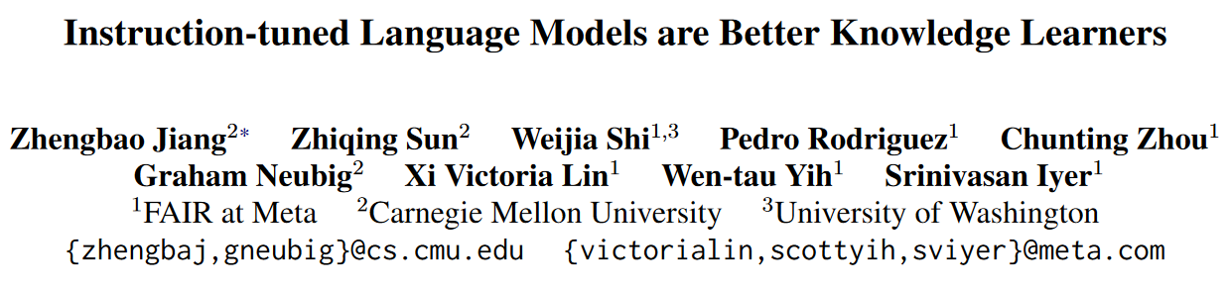
arXiv 2402.12847

Slide 2
Abstract
Update factual knowledge in LLMs ==> continued training.
Standard way: continued pretraining => instruction-tuning on QA pairs.
But LLMs trained this way struggle to answer questions.
QA pairs are generally more straightforward than the documents.
Maybe it is better to train on QA pairs => documents?
(Because it knows how the knowledge is accessed through questions.)
We propose to instruction-tune on questions before training on docs.

Slide 3
Introduction
Knowledge in LLMs becomes outdated as world evolves, or insufficient for specialized or private domains.
We want to know LLMs' ability to learn new knowledge.
The common practice is to continue pretraining on new documents.
We perform an experiment following this training method.
In-domain QA performance consistently increases to 27.6% as the LLM is trained on the documents (even if the perplexity is equal to 1).
Subsequent instruction-tuning improves it to 30.3%.
If the perplexity is equal to 1, why the performance is so limited?

Slide 4
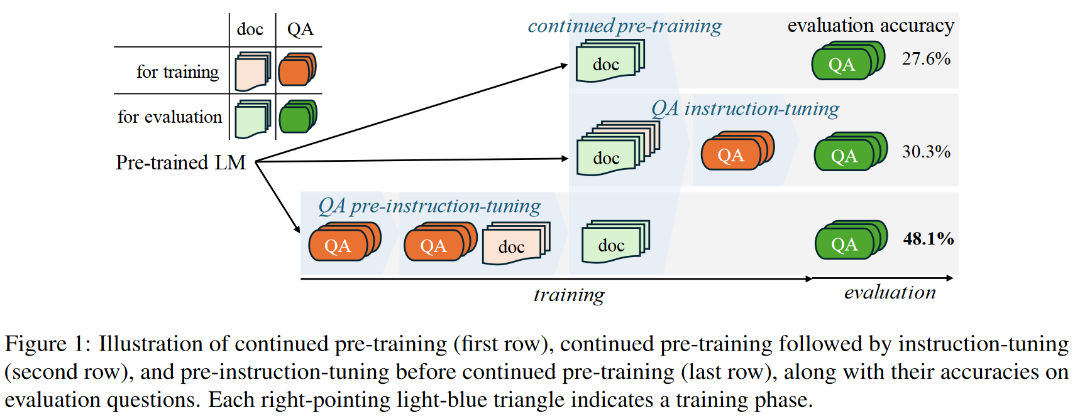
Introduction

Slide 5
Introduction
We found QA pairs are generally straightforward, while the documents tend to be more complex.
We hypothesize that it is beneficial to expose LLMs to QA data before continued pre-training, so that the process of encoding knowledge from complex documents takes into account how this knowledge is accessed through questions.
Experiments demonstrate that models trained this way can better absorb knowledge from new documents.
Ablation Studies show that this is because the model learns how to access knowledge before learning the actual knowledge.

Slide 6
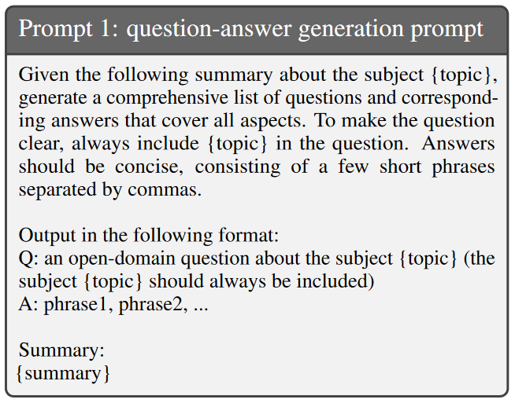
Building a Dataset to Study Continual Knowledge Acquisition
Documents: Wikipedia articles under the "2023" category.
Only the first section of each article is used.
QAs: Generated by publicly available LLMs with the document context.

Slide 7
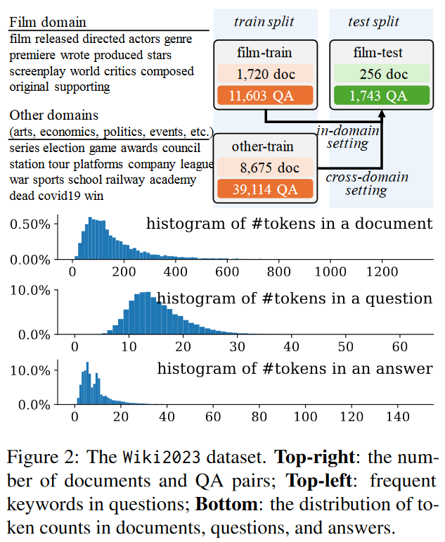
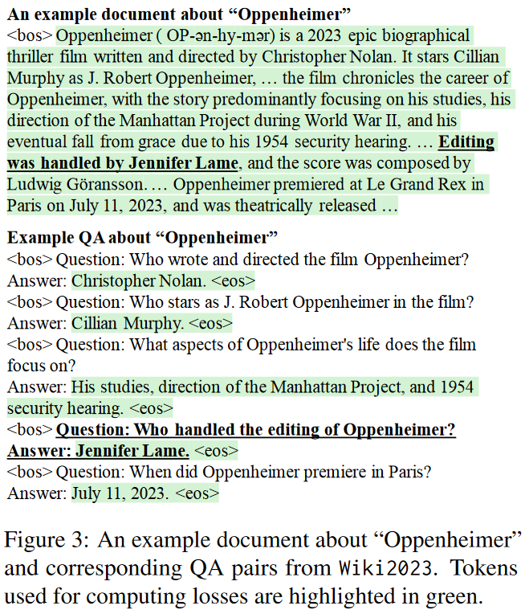
Wiki2023 Dataset

Slide 8
Experimental Settings
LLMs: Llama-2 7B & Llama-2 70B.
Decoding strategy: Greedy.
Training objective: Averaged next-token prediction loss.
Batch size: 256.
Learning rate: 3e-5 for documents, and 5e-6 for QA pairs.
Because the number of loss-computed QA tokens in a single batch is lower.
Metric: Exact match (after normalization, i.e. removing a/an, the, etc.).
Because most answers are short and simple.
Other metrics: answer recall and ROUGE-L.

Slide 9
How Much Knowledge Can LLMs Absorb via Continued Pre-Training Followed by Instruction-Tuning?
An important question is whether the LLMs answer the questions by comprehension or by memorization.
Results from previous work find that the LMs struggle to answer questions about documents they have been trained on.
But they are either using small LMs, using randomly initialized transformers, or without instruction-tuning.
We want to conduct the same experiment following a standard recipe:
Continued pretraining => instruction-tuning.

Slide 10
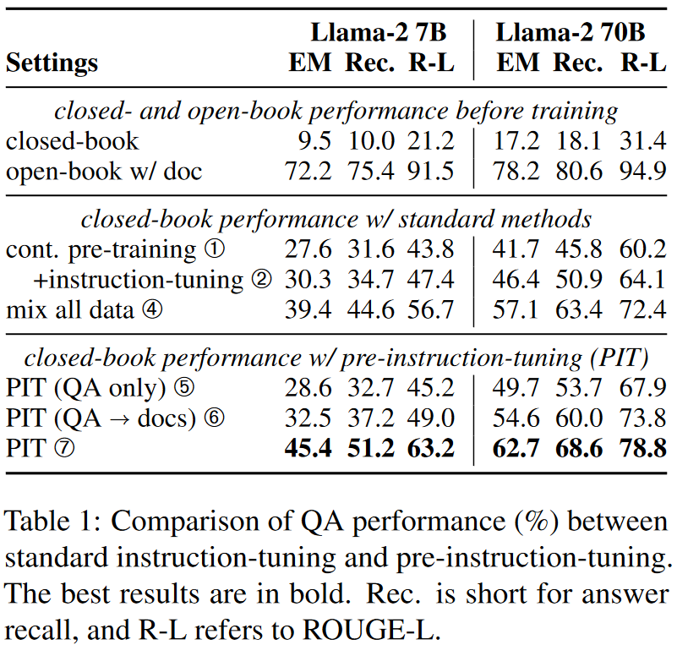
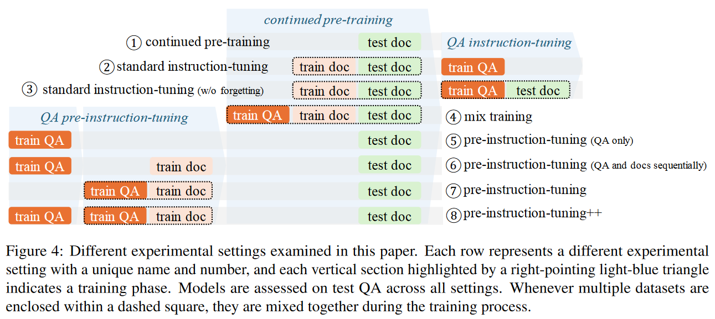
Experiment Settings & Results

Slide 11
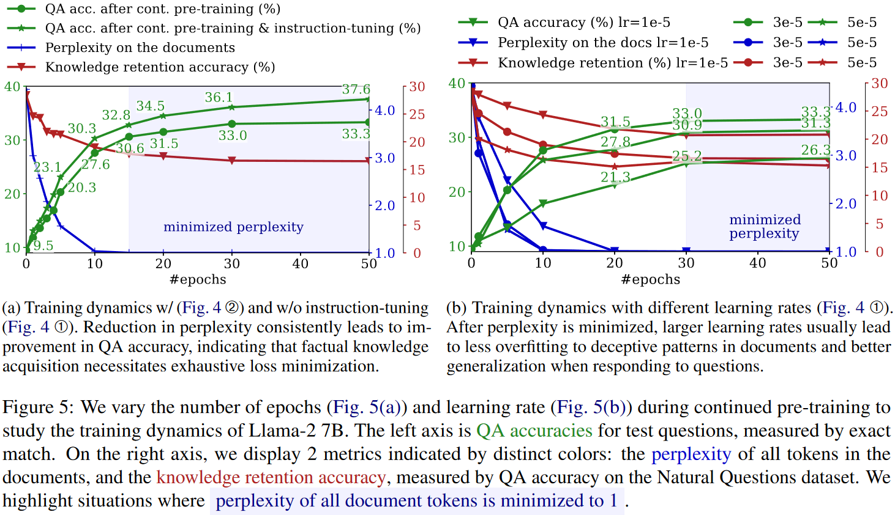
Training Dynamics: Perplexity and Generalization

Slide 12
Improving LLMs in Absorbing Knowledge from Documents
Target: Improve LLMs' ability to absorb knowledge from documents.
Challenge: The gap between the way knowledge is presented in raw documents and how it is accessed through question-answering.
Observation: QA pairs are relatively easier to understand.
Hypothesis: It is beneficial to expose LLMs to QA pairs before continued pre-training so that it knows how the knowledge is accessed.
Previous work [1] studies this problem on a GPT-2-like transformer from scratch with synthetic biographies and evaluates its ability by answering questions. Findings: Biographies + questions of ½ biographies ==> strong generalization. Biographies => questions ==> failure.
[1] Physics of language models: Part 3.1, knowledge storage and extraction.

Slide 13
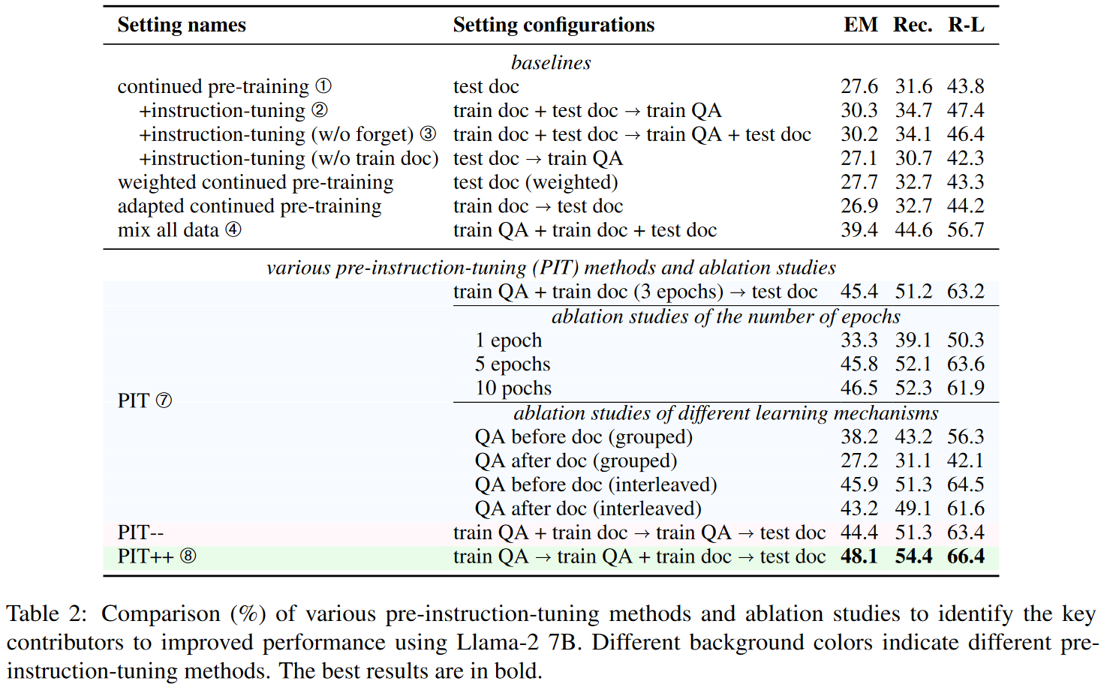
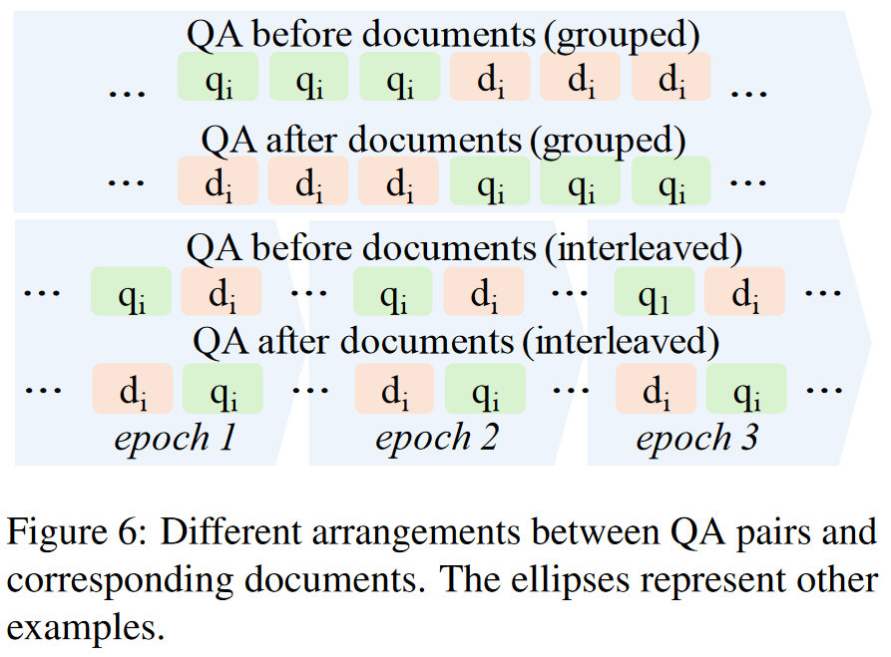
Ablation Studies & Pre-instruction-tuning++

Slide 14
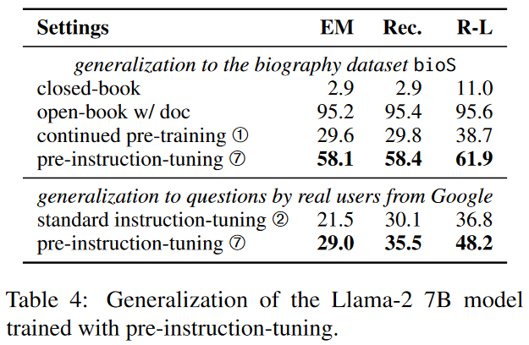
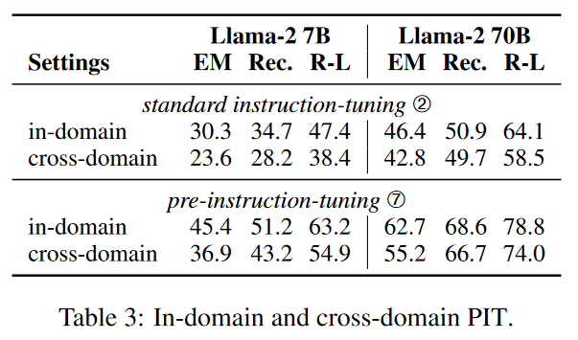
Cross-domain Generalization

Slide 15
Conclusion
Hypothesis: It is beneficial to expose LLMs to QA data before continued pre-training, so that the process of encoding knowledge from complex documents takes into account how this knowledge is accessed through questions.
Use pre-instruction-tuning?

Slide 16
Ends.

